Slide 1
Fundamentals of Project Management
MS(PM) MSP 705 Semester: 1 Fall 2024
Lecture # 3.2
FACULTY OF MANAGEMENT STUDIES - BUKC

Slide 2
Project Management Organizational Structure
1. Functional Organizational Structure:
  A functional structure is a hierarchical type, wherein people are grouped as per their area of specialization and supervised by the functional manager with expertise in the same field so that their skills can be effectively utilized and the organization’s objective can be achieved. Here are the key features of Functional Organizational Structure:
    All authority, budget allocation, and decision-making power stay with the functional manager.
    A project manager has no role in this type of structure.
    Even if a project manager exists, the role will be very limited and he has to ask the functional manager for his requirements.
    A project manager may have the title of a coordinator or an expediter.
  The Functional project management structure is suitable for an organization, which has ongoing operations such as manufacturing and production operations.

Slide 3
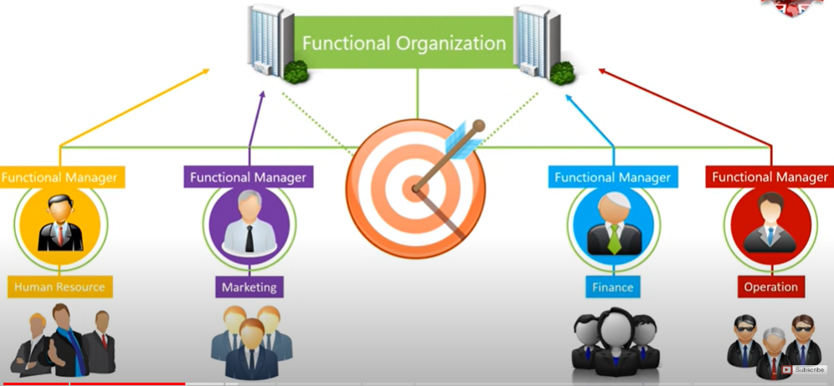

Slide 4
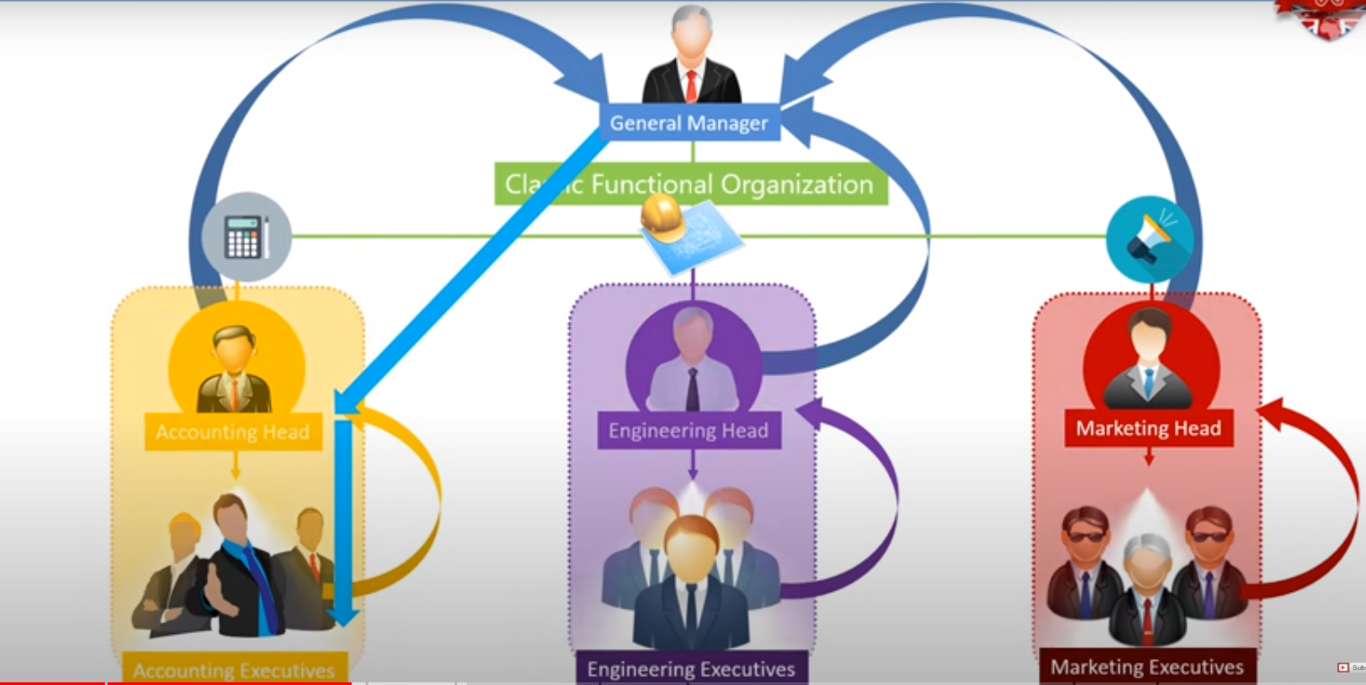

Slide 5
ADVANTAGES OF FUNCTIONAL STRUCTURE:
Employees are grouped as per their knowledge and skills.
Job responsibilities and reporting are straight to the functional head, and the hierarchy path is clear.
Employees have a clear career growth path.
Within the functional department communication, cooperation and coordination are excellent.

Slide 6
DISADVANTAGES OF FUNCTIONAL STRUCTURE:
The employee may become lazy due to repeating the same type of work.
Conflicts may arise due to the promotion of another employee.
The functional manager pays attention to only his department; he usually doesn’t care for other teams or sections.
Poor communications and poor inter-department coordination.
Delays in decision-making due to bureaucratic hierarchy.

Slide 7
Projectized Organizational Structure
  Projectized organizations are nearly the opposite of functional organizations. The focus of this type of organization is the project itself. The idea behind a projectized organization is to develop loyalty to the project, not to a functional manager.

Slide 8
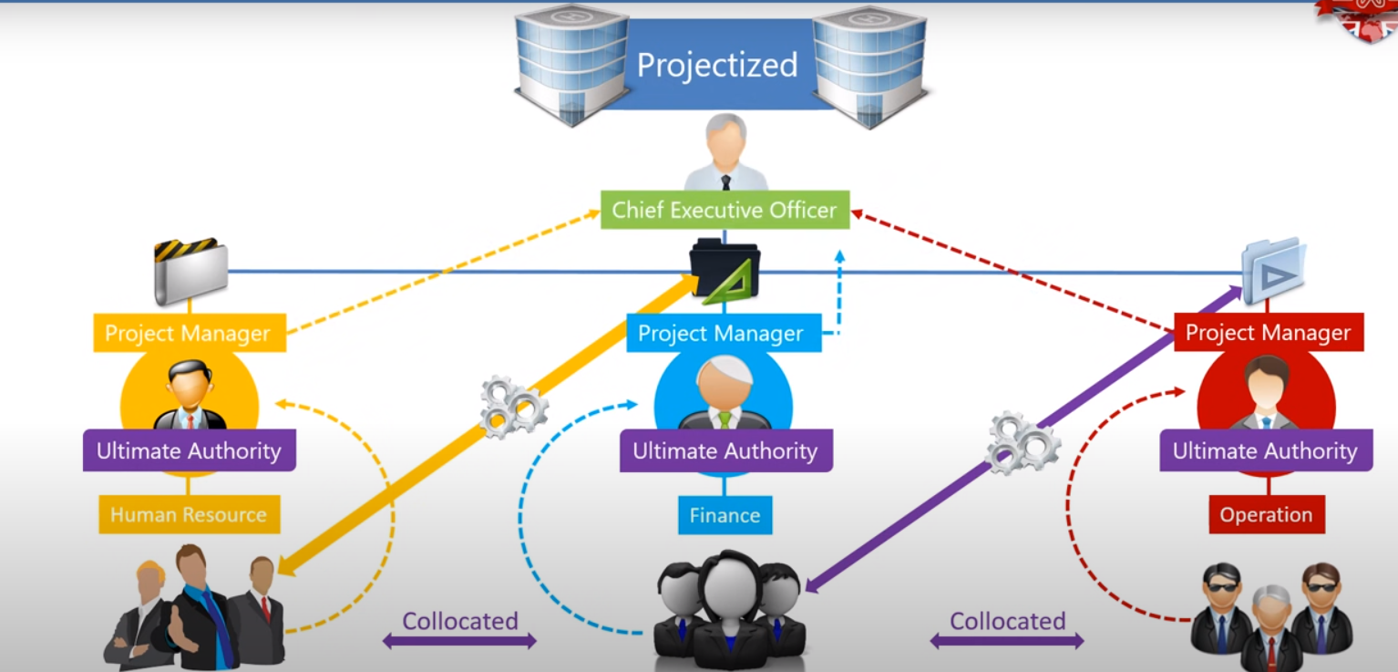

Slide 9
Projectized Organizational Structure
    ADVANTAGES OF PROJECTIZED STRUCTURE:
    Strong communication with a single reporting system.
    Flexibility in trade-offs and decision making.
    Fast decision making.
    DISADVANTAGES OF PROJECTIZED STRUCTURE
    Authority and power can make project managers arrogant.
    The work environment can be stressful because there is always a deadline (milestones).
    Team members have a sense of insecurity because once the project finishes, they may lose their jobs.
    If the project gets elongated, the cost of employees and equipment can go higher.

Slide 10
Matrix Organizational Structure
In matrix structures, usually employees have two bosses to whom they may have to report. The authority of the functional manager flows vertically downwards and the authority of the project manager flows sideways. Since, the authorities flow downward and sideways, this structure is called the Matrix Organization Structure. Which boss is more powerful depends upon the type of matrix structure
  TYPES OF MATRIX ORGANIZATIONS:
  Matrix organization structure can be further divided into three categories:
  Strong Matrix,
  Balanced Matrix, and
  Weak Matrix.

Slide 11
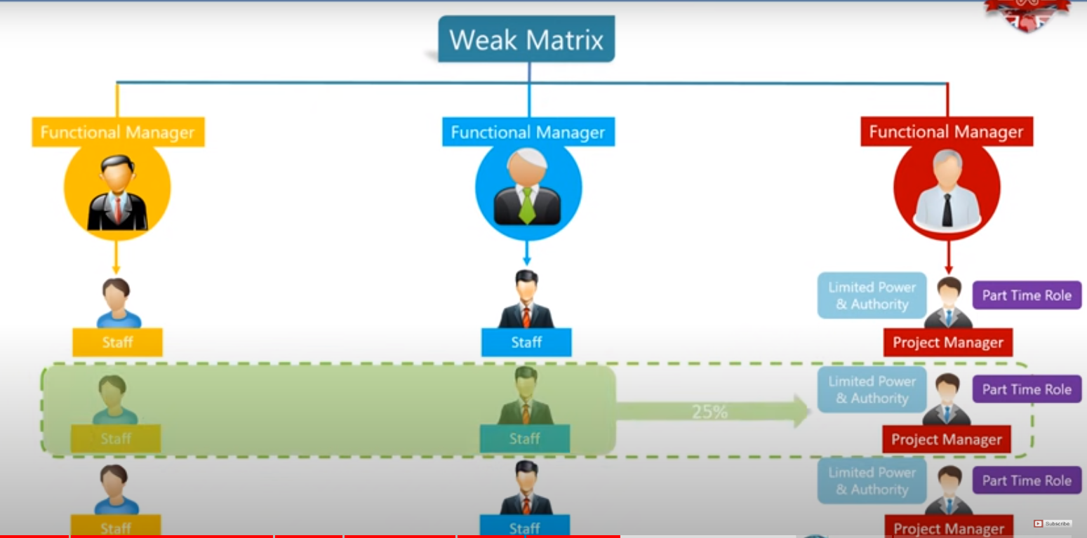

Slide 12
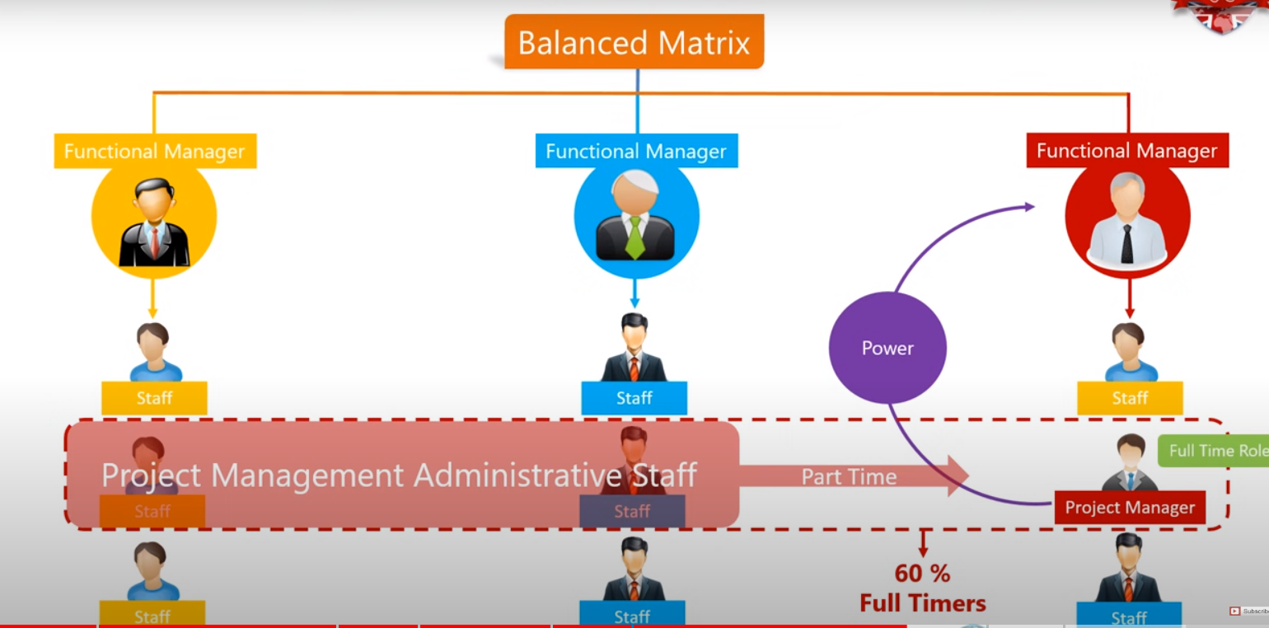

Slide 13
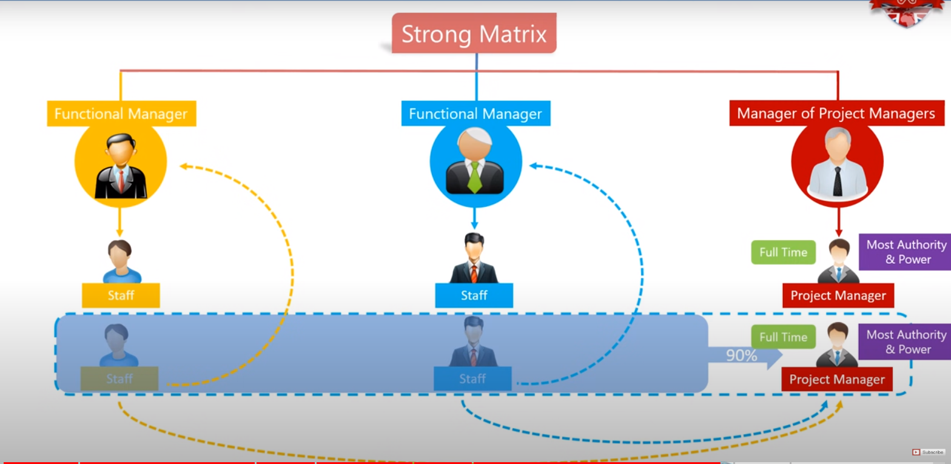

Slide 14
Advantages/ Disadvantages of Matrix
Advantages
  Highly visible Project Objectives
  Improved Project Management Control over resources
  More support from functional areas
Disadvantages
  Required extra administration
  Required morethan one boss for project teams
  More complex to monitor and control

Slide 15
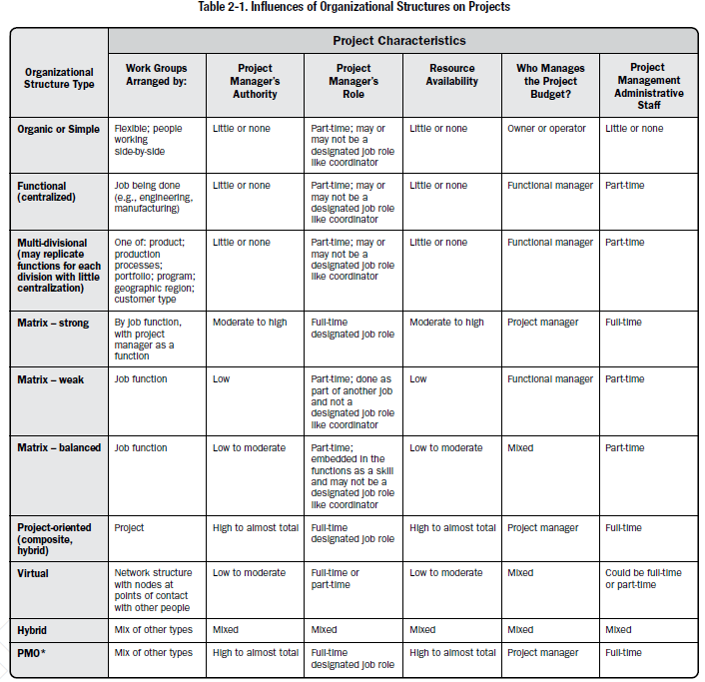

Slide 16
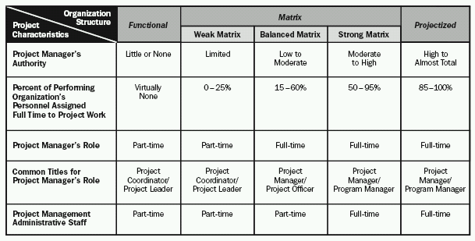
Organizational Influences
A tight matrix is not an organizational structure, but another word for collocation.

Slide 17
Project Coordinator
Weaker than a Project Manager
Not allowed to make budget decisions or overall project decisions
May have some authority to assign / reassign some resources
Found in a weak matrix or functional org

Slide 18
Project Expeditor
Weakest among all
Staff assistant with little or no formal authority
Reports to executives who have project responsibility
Makes sure tasks are completed on time
Found in a functional organization
  A part time job in most organizations

Slide 19
PROJECT MANAGEMENT OFFICE
PMO standardizes the project-related governance, facilitates sharing of resources, methodologies, and techniques.
PMO role can range from project management support functions to the direct management of one or more projects.
Types of PMOs:
Supportive. Consultative role through templates, best practices, training, and access to information.
Serves as a project repository.
The degree of control is low.

Slide 20
PROJECT MANAGEMENT OFFICE
Controlling. support and require compliance through various means.
The degree of control is moderate.
Compliance may involve:
Adoption of project management frameworks or methodologies;
Use of specific templates, forms, and tools; and
Conformance to governance frameworks.

Slide 21
PROJECT MANAGEMENT OFFICE
Directive. Directly managing the projects.
Project managers are assigned by and report to the PMO.
The degree of control is high.
May have organization-wide responsibility.
Role in strategic alignment and delivering organizational value.
Integrates information from strategic projects and evaluates how strategic objectives are being fulfilled.

Slide 22
PROJECT MANAGEMENT OFFICE
PMO is the natural liaison between the organization’s portfolios, programs, projects, and the organizational measurement systems (e.g., balanced scorecard).
The projects supported or administered by the PMO may not be related other than by being managed together.
The specific form, function, and structure of a PMO are dependent upon the needs of the organization that it supports.

Slide 23
PROJECT MANAGEMENT OFFICE
PMO may have the authority to act as an integral stakeholder and a key decision maker of each project to keep it aligned with the business objectives.
The PMO may:
Make recommendations,
Lead knowledge transfer,
Terminate projects, and
Take other actions, as required.

Slide 24
PROJECT MANAGEMENT OFFICE
Primary function of a PMO is to support project managers:
Managing shared resources across all projects;
Coaching, mentoring, training, and oversight;
Monitoring compliance by means of project audits;
Coordinating communication across projects.

Slide 25
Functional Organization in Pakistan
Functional organizations in Pakistan are commonly seen in government bodies and traditional companies. In these organizations, departments operate independently, and project managers have limited authority. Functional heads control resources and decision-making.
  Example: Pakistan International Airlines (PIA)
    PIA operates under a functional organizational structure where various departments like flight operations, engineering, finance, and customer services are managed independently. Each department head (functional manager) is responsible for decision-making within their unit, and projects (e.g., a new route launch) are executed within these functional divisions. The project managers or team leads have to report to the heads of their departments, with less autonomy.

Slide 26
Projectized Organization in Pakistan
Projectized structures are more common in sectors like construction and event management in Pakistan. In this structure, the organization is oriented around projects, and the project manager holds most of the authority.
  Example: Frontier Works Organization (FWO) or National Logistics Cell (NLC)
    FWO, responsible for large-scale infrastructure projects in Pakistan such as highways, tunnels, and bridges, operates in a projectized structure. Each infrastructure project (like the construction of the CPEC roads or the Karachi-Lahore Motorway) has dedicated project teams, and the project manager has full authority over resources, timelines, and decision-making. Once the project is completed, the team is disbanded or reassigned to new projects.

Slide 27
Matrix Organization in Pakistan
Matrix organizations, where employees report to both functional and project managers, are more common in technology, telecom, and consulting companies in Pakistan. These organizations work on multiple projects simultaneously, requiring cross-functional collaboration.
Example: Systems Limited
  Systems Limited, one of Pakistan’s largest IT services and consulting firms, operates under a matrix structure. Employees working on software development, ERP implementation, or consulting projects often report to both their functional heads (like the head of software development) and project managers (managing a specific client project). For example, a software engineer might be working on several client projects at once, and decisions are made collaboratively between project managers and functional heads.

Slide 28
Weak Matrix Organization
In a weak matrix, functional managers have more authority than project managers. Project managers typically act more as coordinators or administrators rather than having direct control over the project. Employees primarily report to their functional managers, and project managers have limited decision-making power.
  Example: Punjab Information Technology Board (PITB)
    PITB, responsible for implementing various government IT projects like e-governance systems, operates with a weak matrix structure. The functional managers in different departments (e.g., software development, networking, finance) hold more control over resources and personnel. When an IT project is initiated (like developing a digital system for government operations), the project manager coordinates between departments but has limited authority over the team's allocation and decision-making. The functional managers decide which staff can be assigned to a project, and the project manager mostly ensures that tasks are completed.

Slide 29
Balanced Matrix Organization
In a balanced matrix, authority is shared relatively equally between functional managers and project managers. Both parties collaborate, and the project manager has more influence than in a weak matrix but still shares authority with the functional manager.
  Example: Zong 4G
    Zong 4G, a major telecom operator in Pakistan, uses a balanced matrix structure for its projects. When launching new services, such as expanding 4G networks or introducing new data packages, project managers work alongside functional heads from departments like IT, marketing, and network operations. For instance, if Zong plans to roll out 4G services in a new region, the project manager collaborates with functional departments to allocate resources, set timelines, and manage the budget. The functional managers retain authority over their teams, but the project manager has significant influence over the project’s execution. Both work together to ensure the project's success.

Slide 30
Strong Matrix Organization
In a strong matrix, the project manager holds more authority than the functional managers. Project managers have significant control over resources, decision-making, and project execution. Functional managers play a supportive role, primarily providing expertise or resources as needed.
  Example: NESPAK (National Engineering Services Pakistan)
    NESPAK, one of Pakistan’s largest engineering consulting firms, often follows a strong matrix structure for large infrastructure projects like dam construction or highway development. The project manager assigned to a major project (such as the construction of a dam) has substantial authority over all aspects of the project, from resource allocation to timelines and budgeting. Functional managers in areas like civil engineering, design, and procurement provide support and technical expertise, but the project manager makes the key decisions and is accountable for the project's success.

